Slide 1
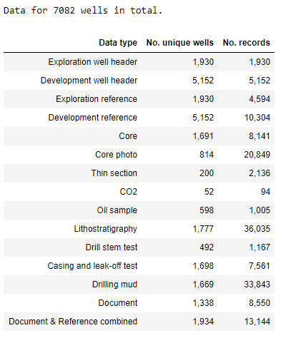

Slide 2
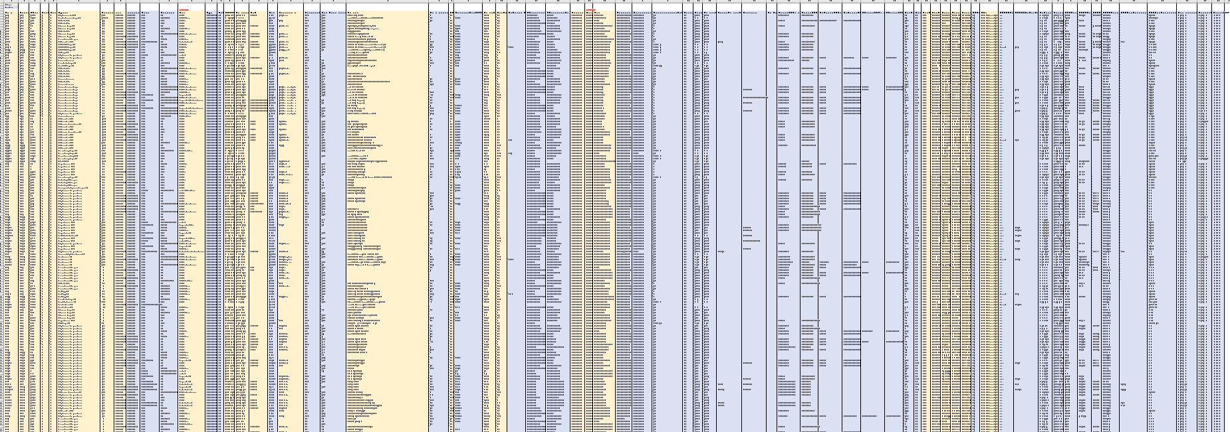

Slide 3
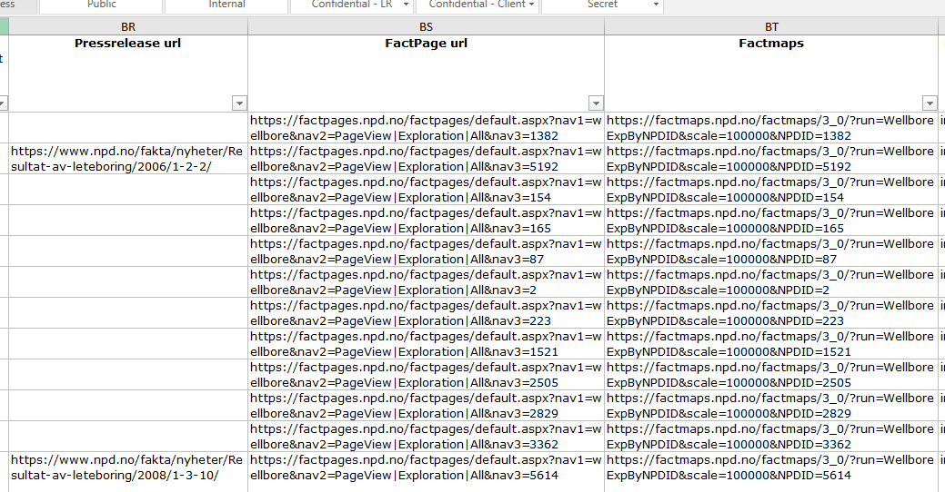
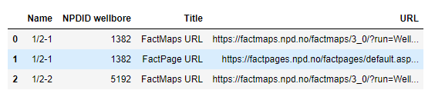
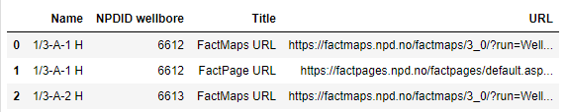

Slide 4
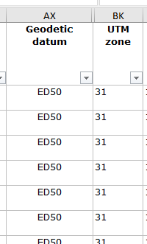
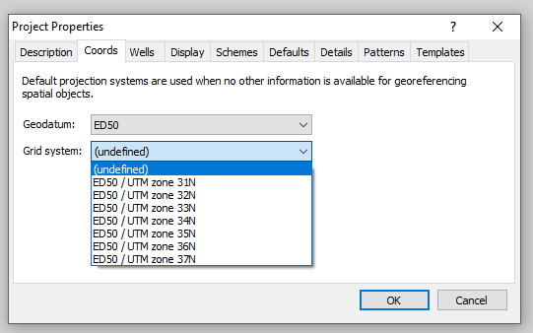
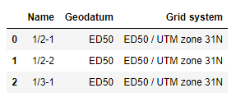

Slide 5
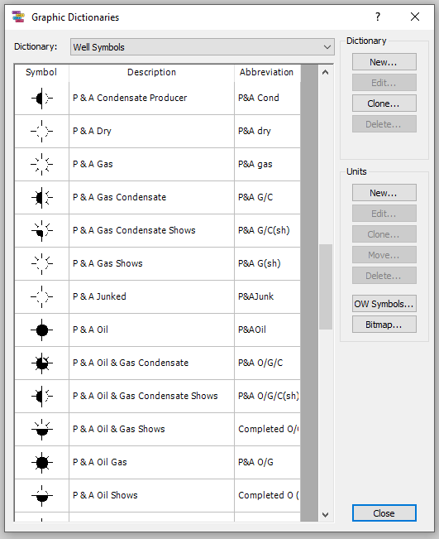
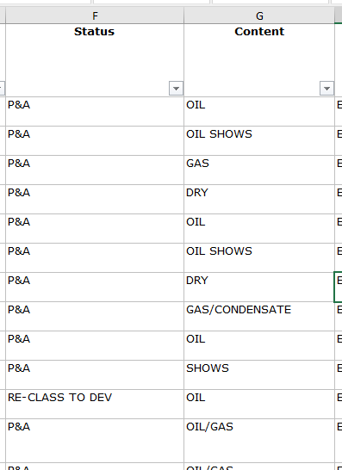
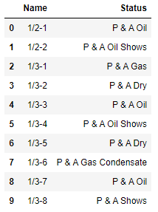

Slide 6
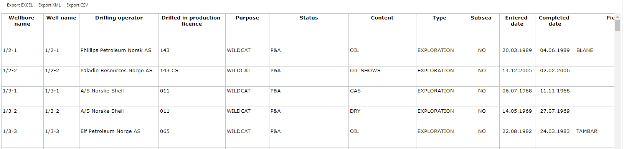
Exploration well headers (74 columns,

Slide 7
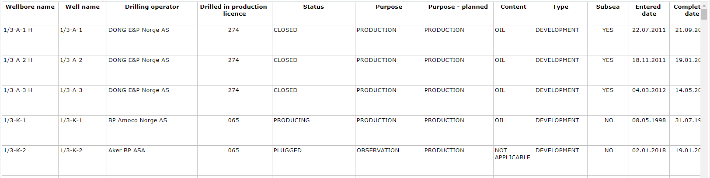
Development well headers

Slide 8
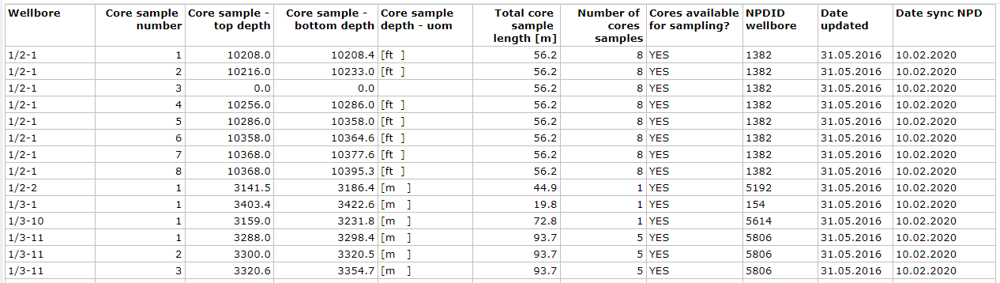
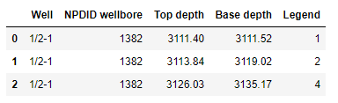
Cores

Slide 9
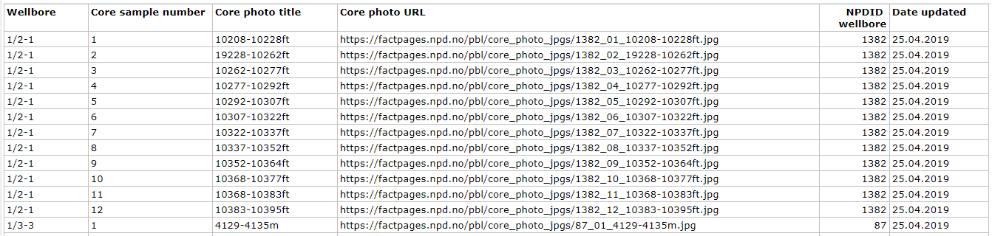
Core photos

Slide 10
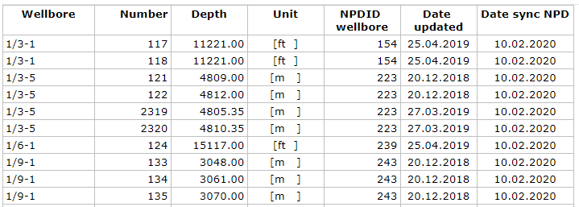
Thin sections

Slide 11
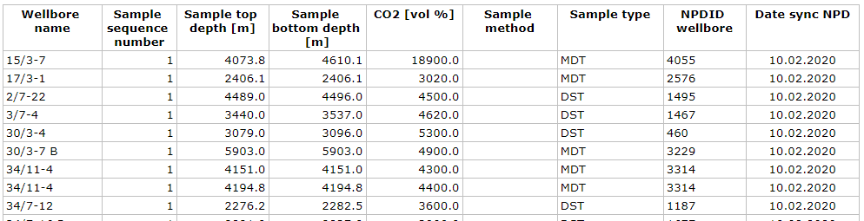
CO2

Slide 12
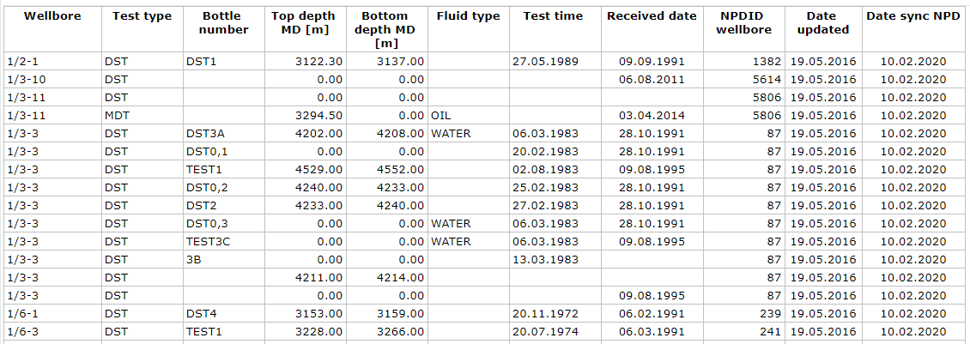
Oil samples

Slide 13
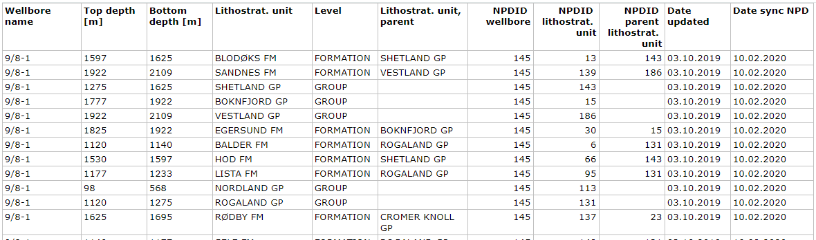
Lithostratigraphy

Slide 14
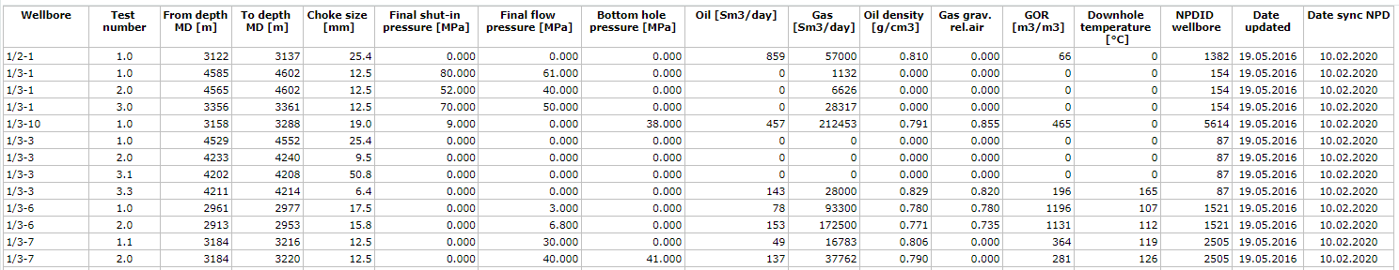
Drill stem tests

Slide 15
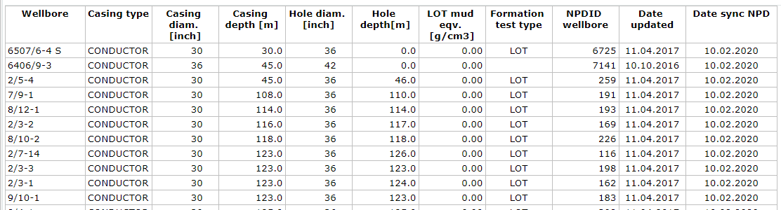
Casing and leak-off tests

Slide 16
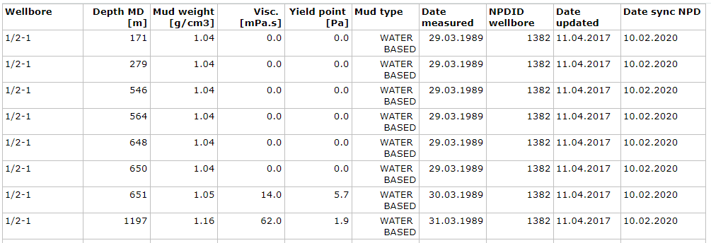
Drilling mud

Slide 17
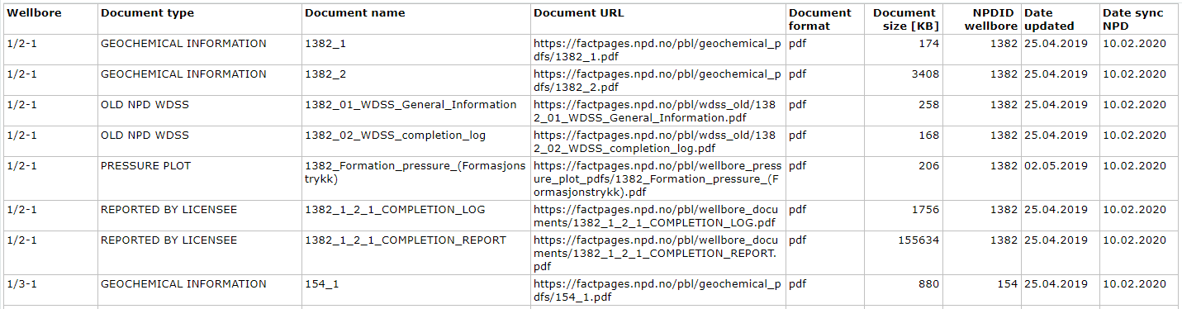
Documents

Slide 18
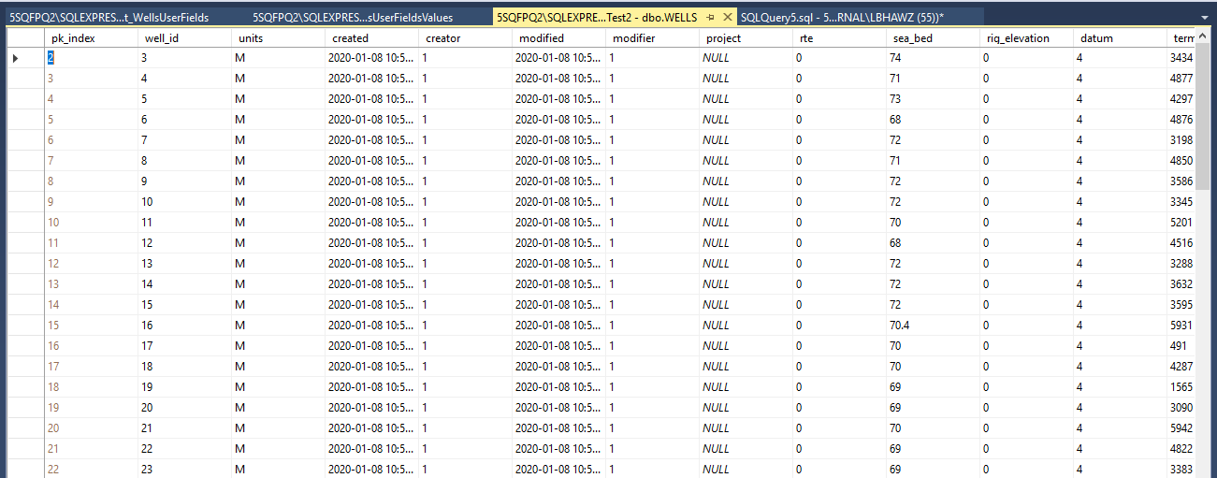
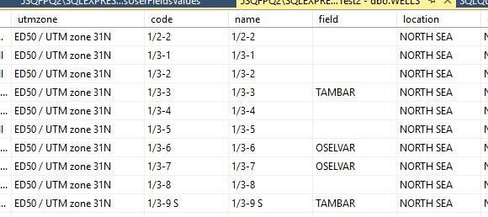
dbo.Wells

Slide 19
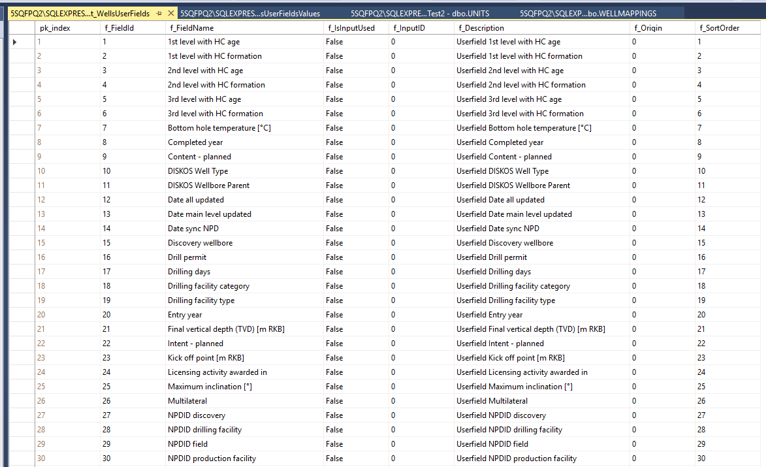
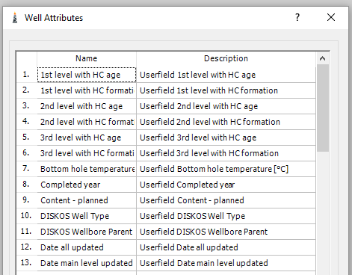
dbo.WellsUserFields
Populates Wells Attributes dialogue

Slide 20
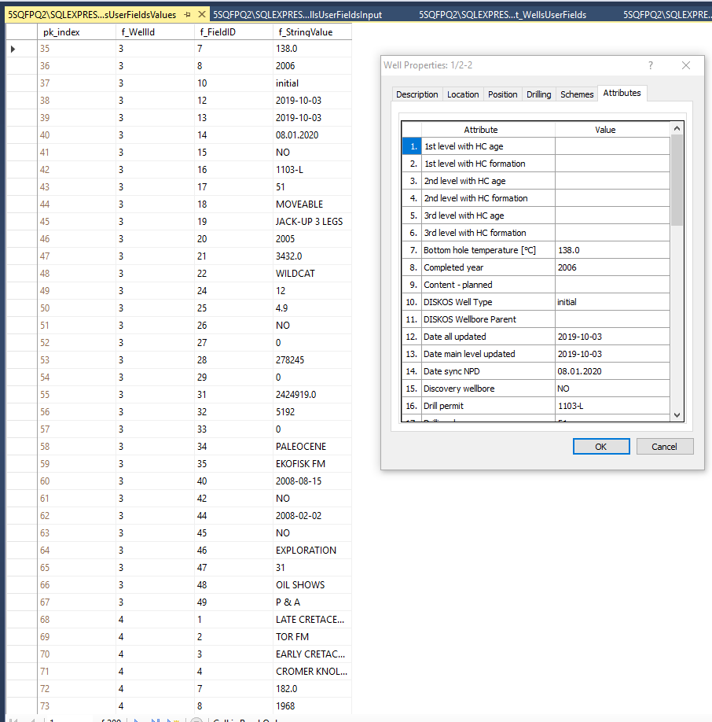
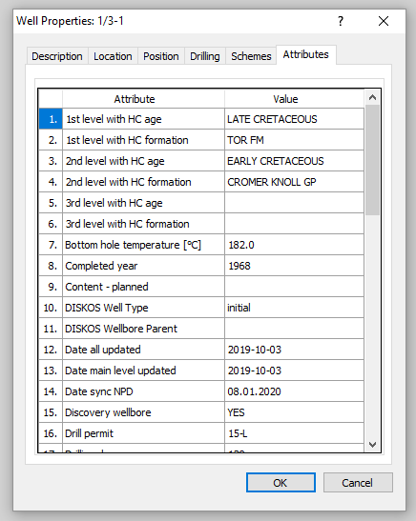
dbo.WellsUserFieldsValues
Note that dbo.WellsUserFieldsInput is empty

Slide 21
well_id data_type top_depth symbol_id pk_index top_age base_age f_interpid creator modifier abr source attr top_boundary base_depth base_boundary legend interpreter created modified obsno mindepth maxdepth remark geofeature dipangle dipazimuth age owconf owqual owkind owbaseconf owbasequal owbasekind
13173 113 315 0 1 NULL NULL NULL 1 345 3 Solmar Mb 38902.7059490741 38908.3945601852 0 0 0 0 0 0 NULL NULL NULL NULL NULL NULL

